Slide 1
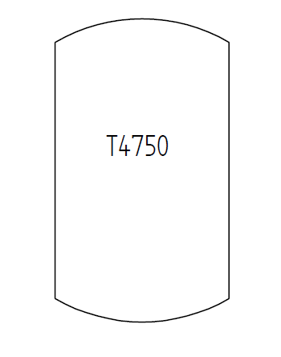
Test Case E13V01 – Tank with Plant Structure Information
Tank with tag name
(no information about tag name parts: prefix, sequence number, suffix).
The tank is part of a PlantSection with PlantSectionName „Brewing Section“. The PlantSection s part of the following hierarchy:
Enterprise „DEXPI Beer Inc.“
Site „Cologne“
IndustrialComplex „Beer Complex“
ProcessPlant „Kölsch Plant“
PlantSection „Brewing Section“
T1301

